Slide 1
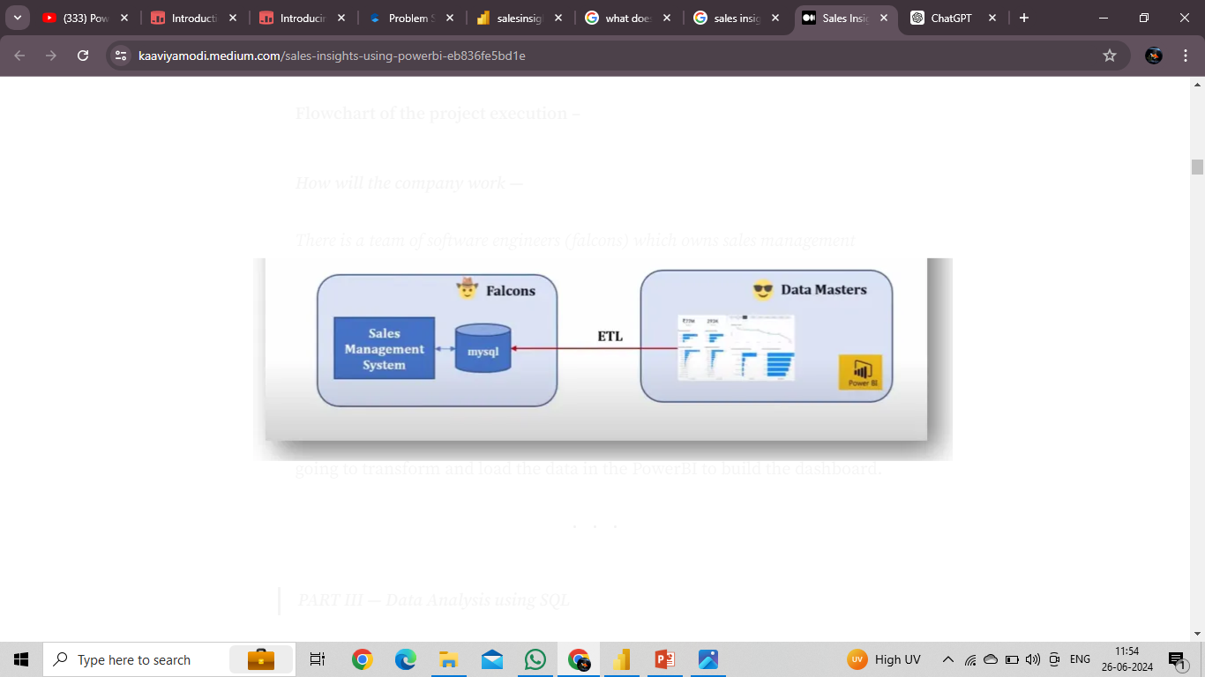
Sales Insights

Slide 2
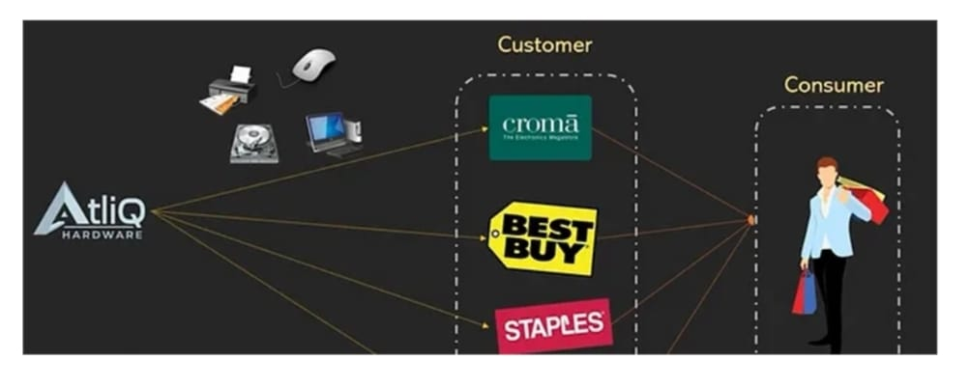
Problem Statement
Atliq hardware is a company which supplies computer hardware and peripherals to many of the clients some are called excel stores,nomad stores,electricals sara stores and so on across india and they supply all these equipment to them now atliq hardware has a head office in delhi and they have lot of regional offices throught the india now bhavan patel is the sales director of atliq hardwares and he is facing lots of challenges as the market is growing dynamically now the challenge is he is facing an issue in terms of tracking the sales. So the Sales director decides to invest in data analysis project and he would like to build power BI dashboard that can give him real time sales insights.

Slide 3
Data Sources
Sales customers
Sales date
Sales markets
Sales products
Sales transactions
Technologies Used:
Mysql
Powerbi

Slide 4
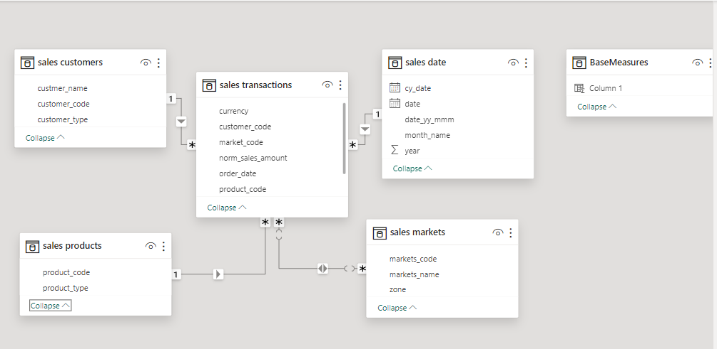
Model View(star schema)

Slide 5
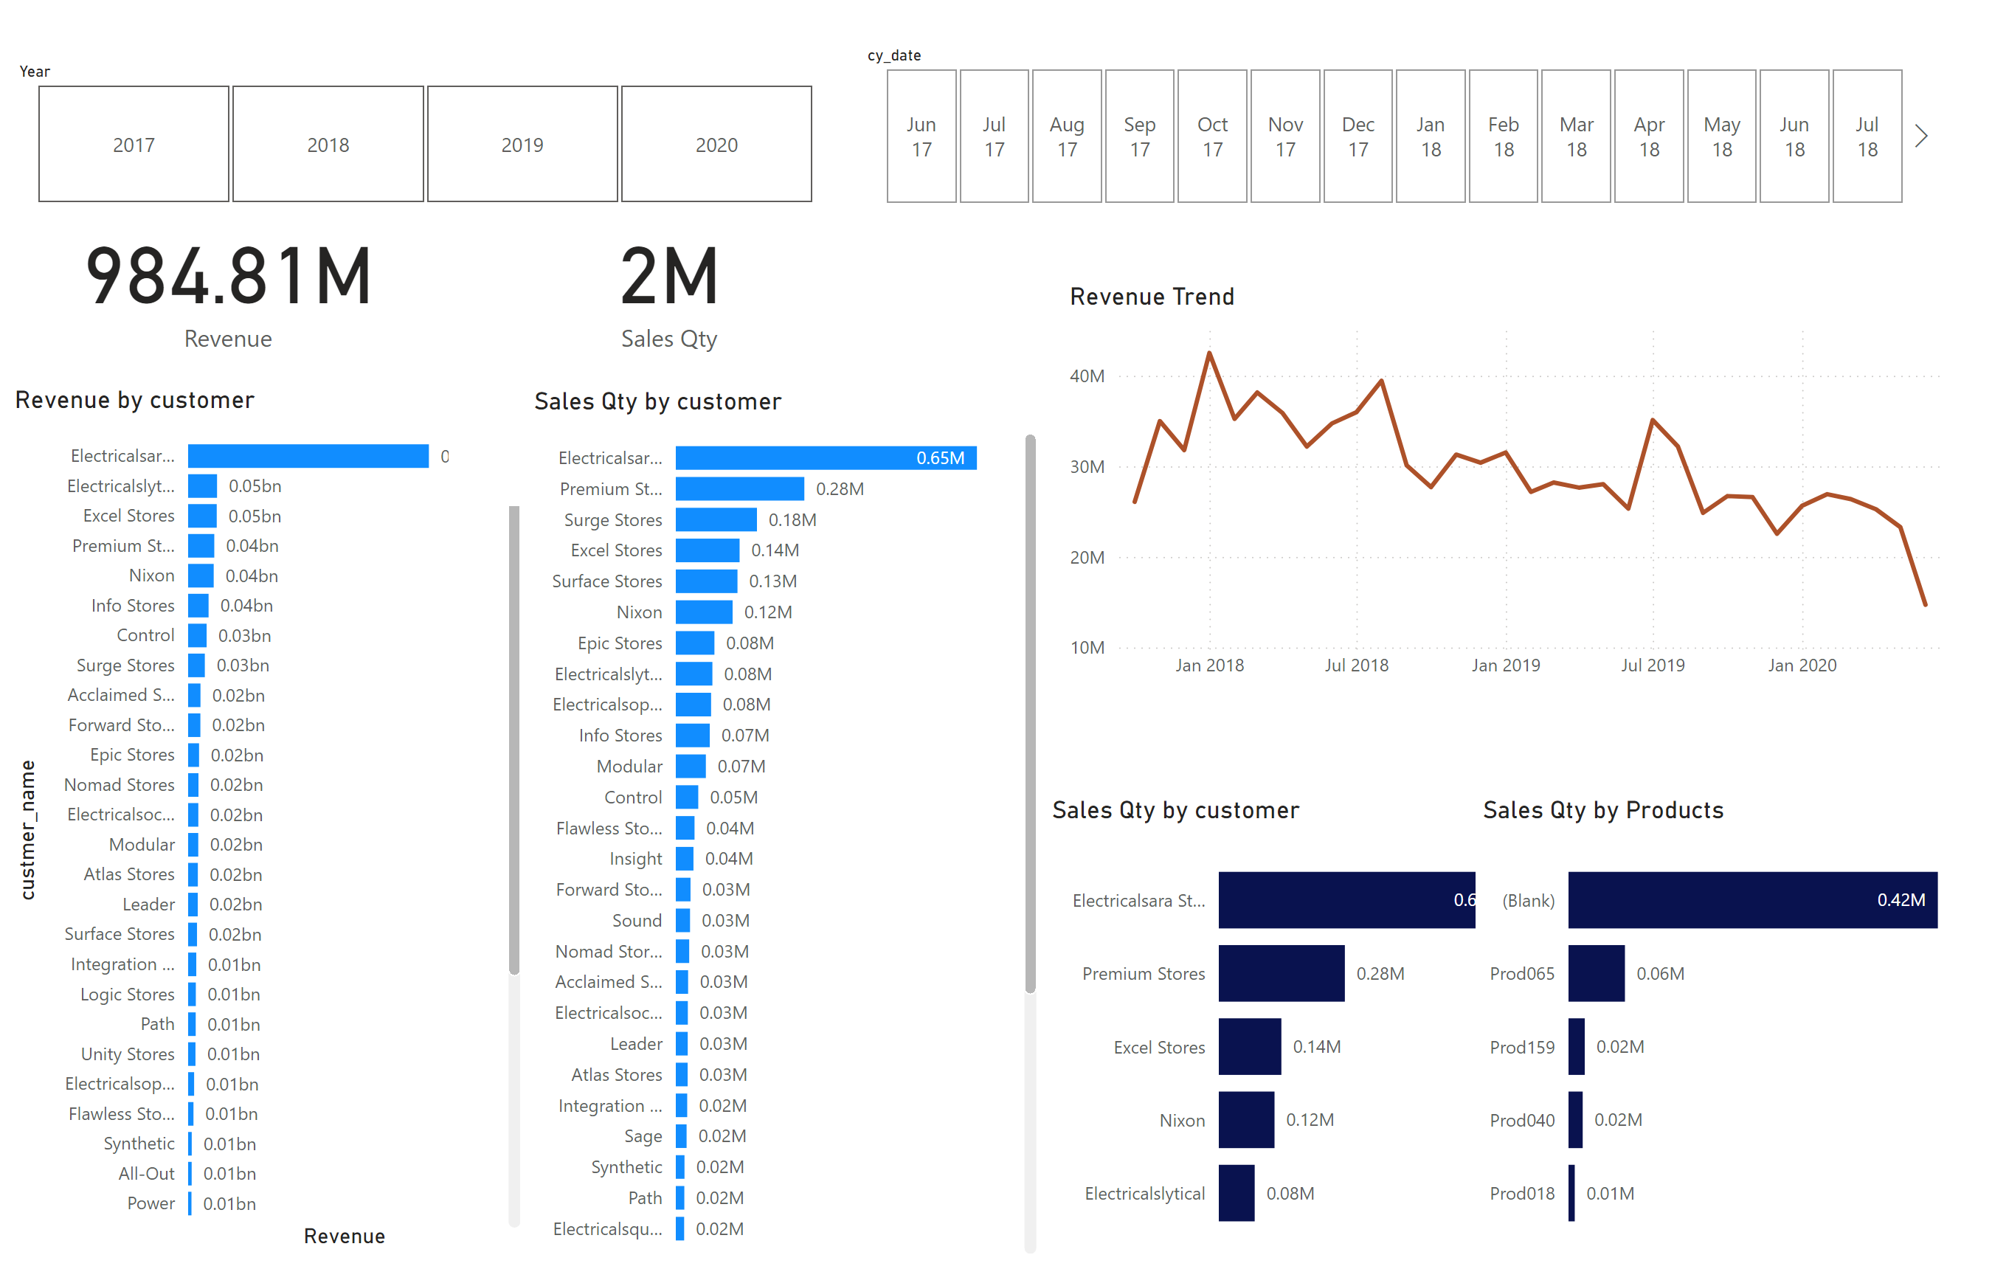
Page 1
Published report

Slide 6
Charts used: Bar chart for revenue by customers and so on line chart for revenue trend

Slide 7
outcomes:
This dashboard helps the sales director make data-driven decisions about the company's sales strategy. The dashboard provides insights such as:
The top five markets for revenue and profit
The top five customers and products
The years with the highest revenue and profit
The zone that contributes the most to revenue
The return on investment for certain locations

Slide 8
https://app.powerbi.com/groups/me/reports/7f0cd599-3f74-436a-96a1-1d7434360683/ReportSection?experience=power-bi

